Slide 1
FedEx Vehicle Telemetry
Group 4

Slide 2
Team and responsibilities
Mohan Sri Krishna Kopuru (Front End and Graphic Designer)
Nemat Parween (Front End Developer)
Viswadeep Lebakula (Front End Developer)
Harish Kumar Manchukonda (Back End & Database Designer)
Swastik Dighe (Back End Developer)

Slide 3
Objectives & goals
To develop a Manager Dashboard for Route tracking and Vehicle management.
To develop a Single website for multiple platforms.
Ease of Access & User friendly design
Minimum redundancy in database.
assumptions
FedEx System will provide needed data in real time
There are no constraints on server storage or processing power
Mobile devices will at times have limited or no data coverage
At system launch, all existing vehicles will be pre-loaded into the system
Login authentication will be handled by FedEx LDAP

Slide 4
introduction
Vehicle Telemetry
Maintenance & Use patterns
Historical and real time data concerning vehicle use and maintenance
Vehicle Specs (Make ,model, total time in service,…)
Vehicle Use history (Miles traveled , average engine idle time….)
Route Information
Record of vehicle drive path
Route Summary metrics map

Slide 5
AGENDA
Preliminary Design Drawings from Checkpoint 1
Design Walkthrough Snapshots.
Feedbacks Incorporated.
Dashboard Snapshot
Vehicle Maintenance and Route Tracking Snapshot.
Database Setup.
Live Demo
Future Work

Slide 6
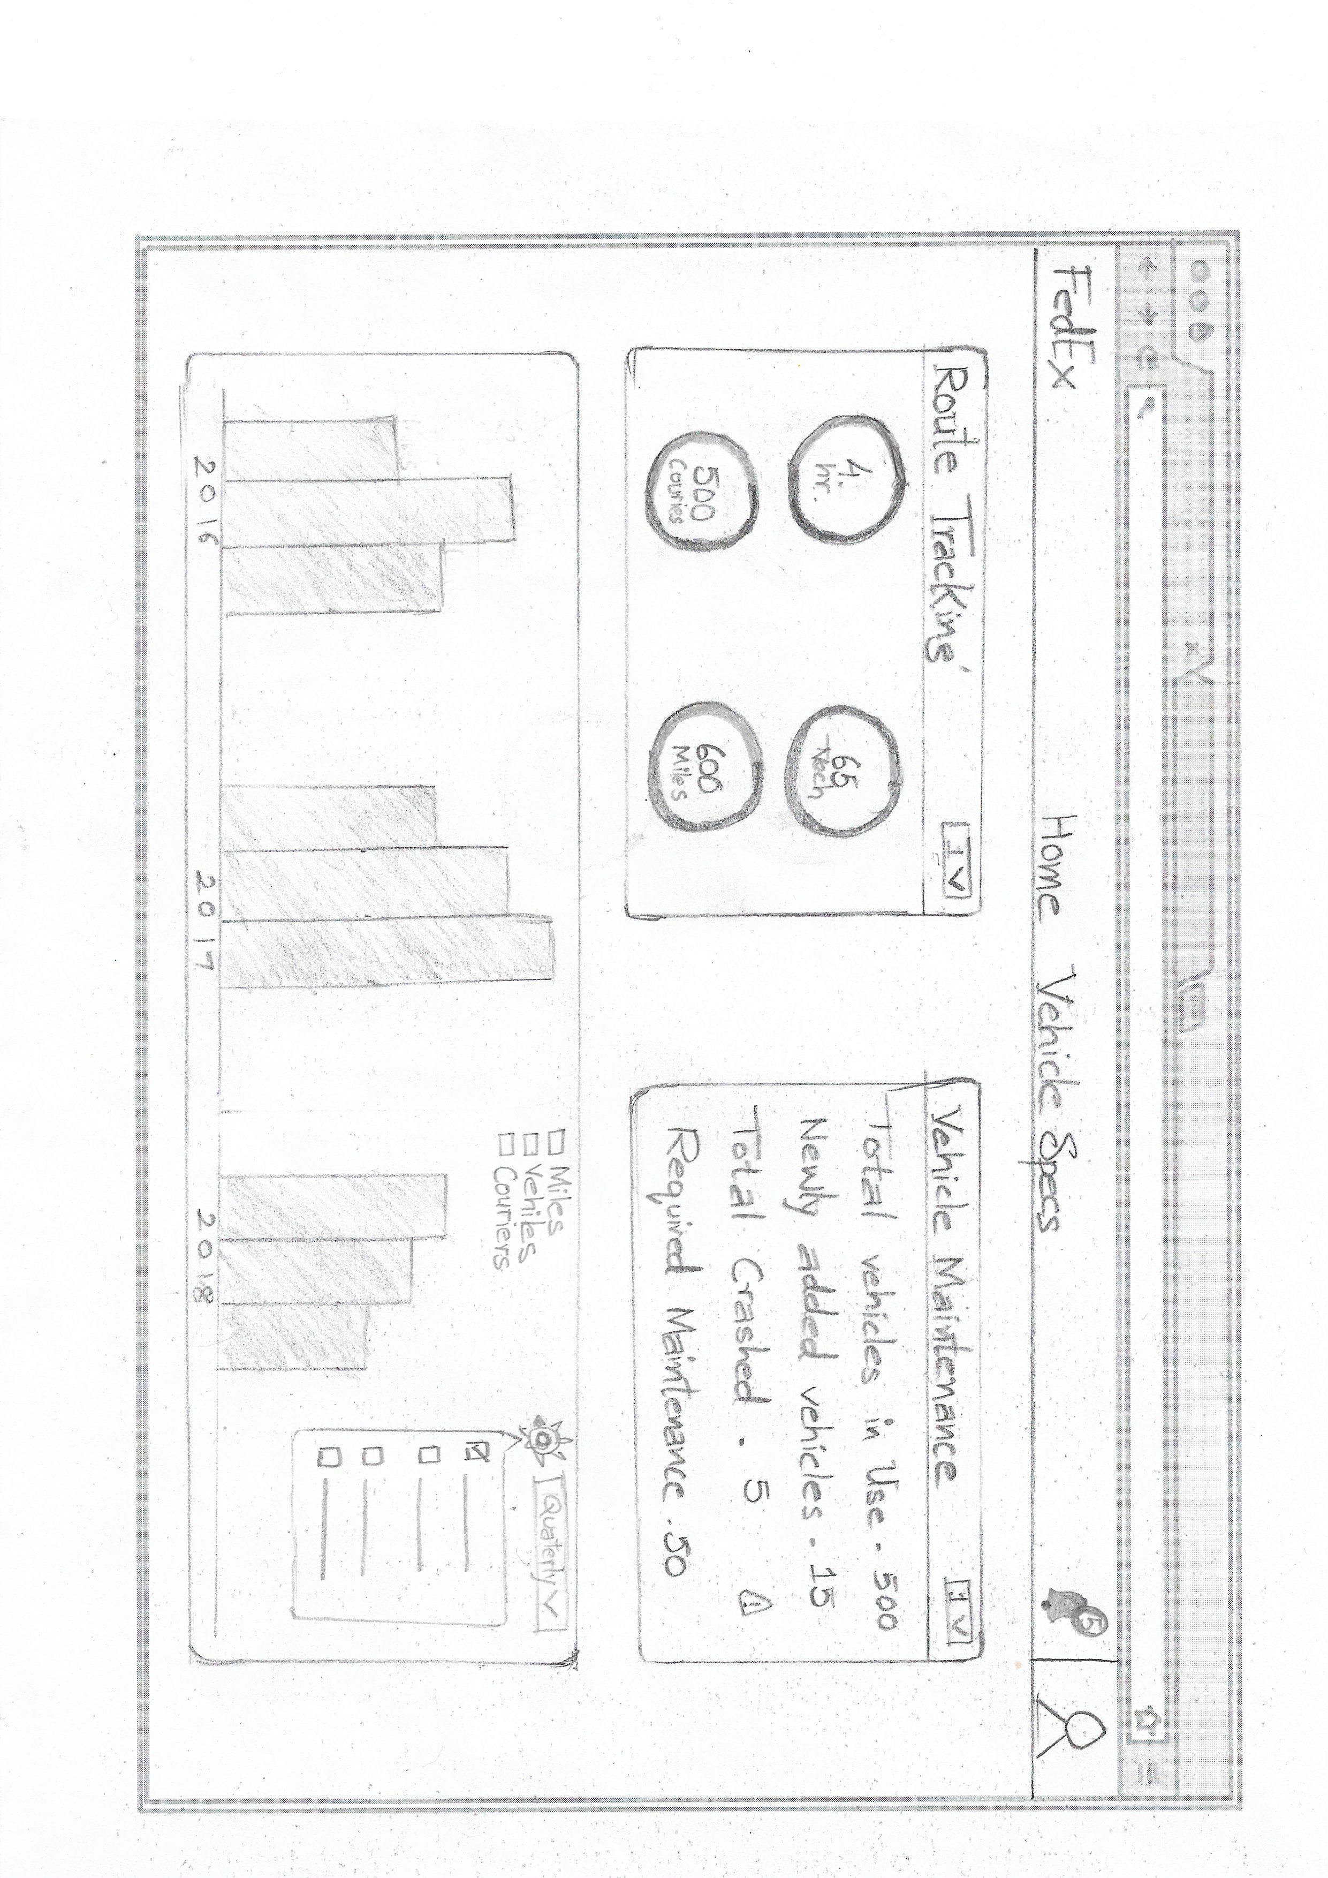
Preliminary Design Drawings from Checkpoint 1- Dashboard

Slide 7

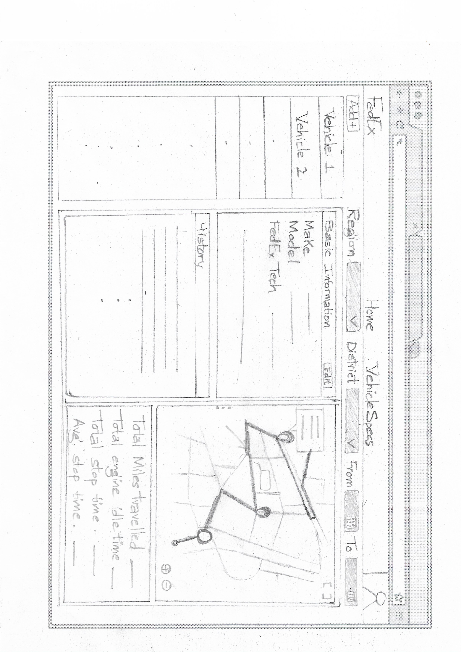
Vehicle maintenance & Route tracking

Slide 8
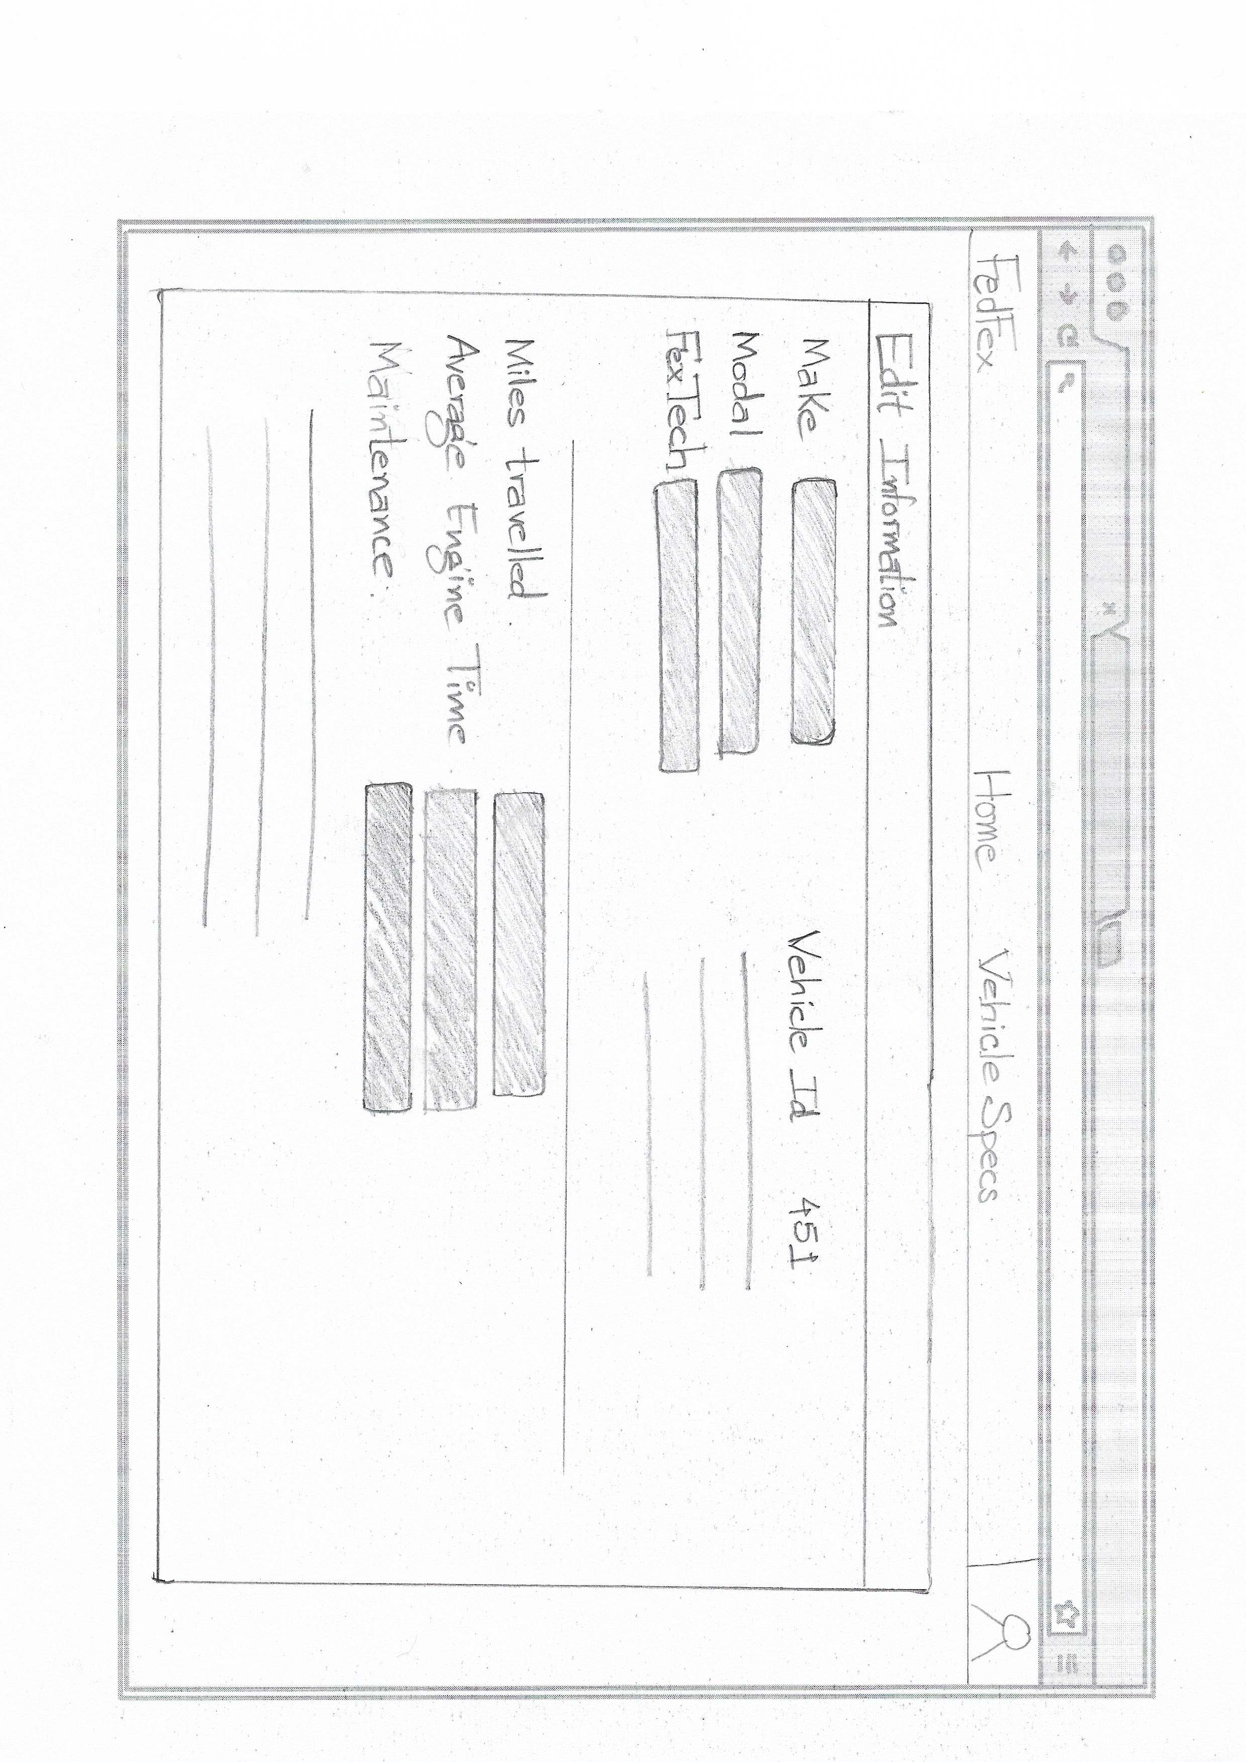
Vehicle maintenance (Edit mode)

Slide 9
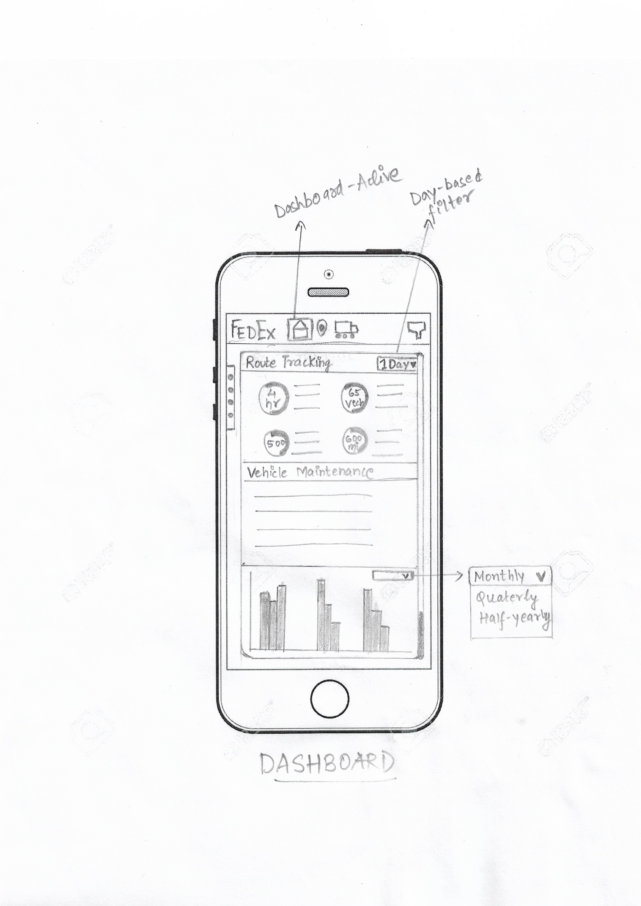
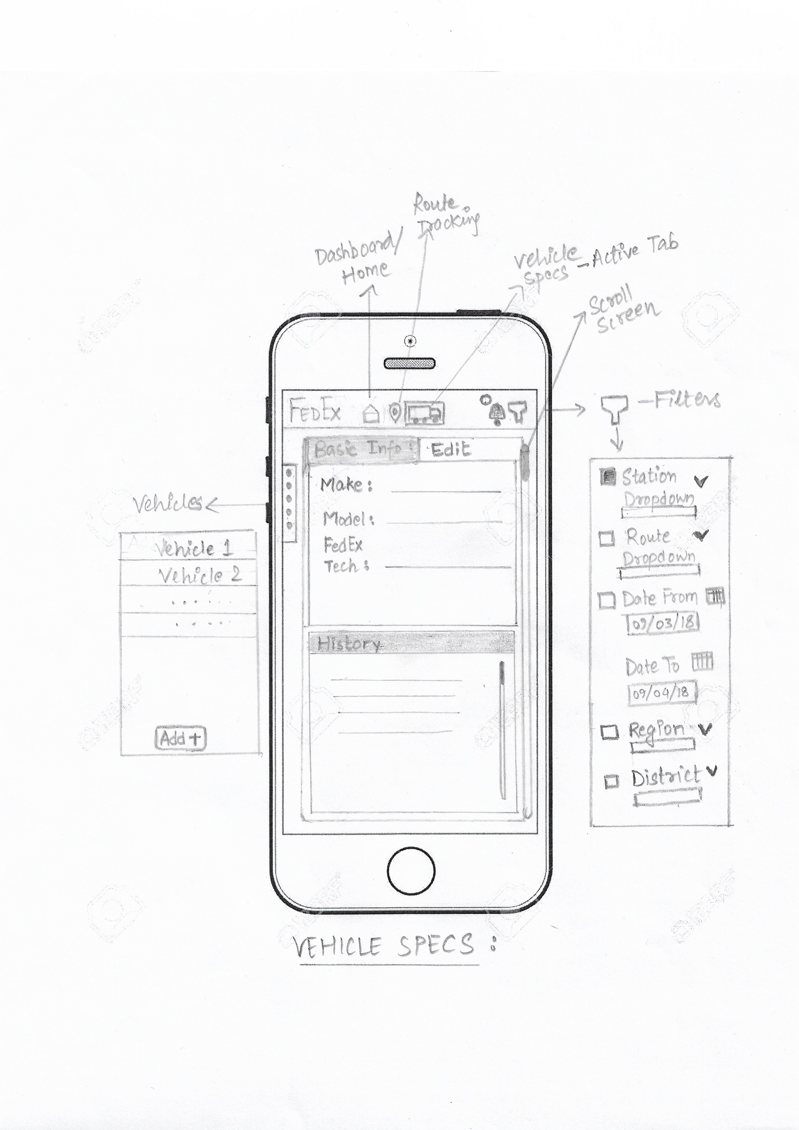
application in mobile view

Slide 10
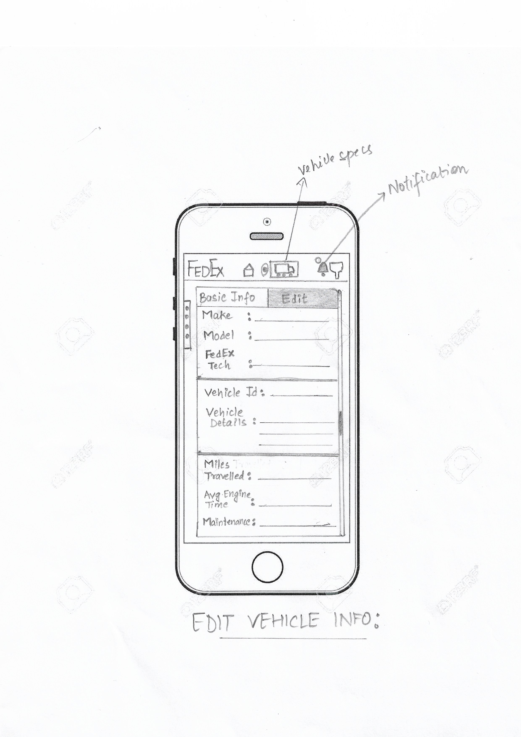
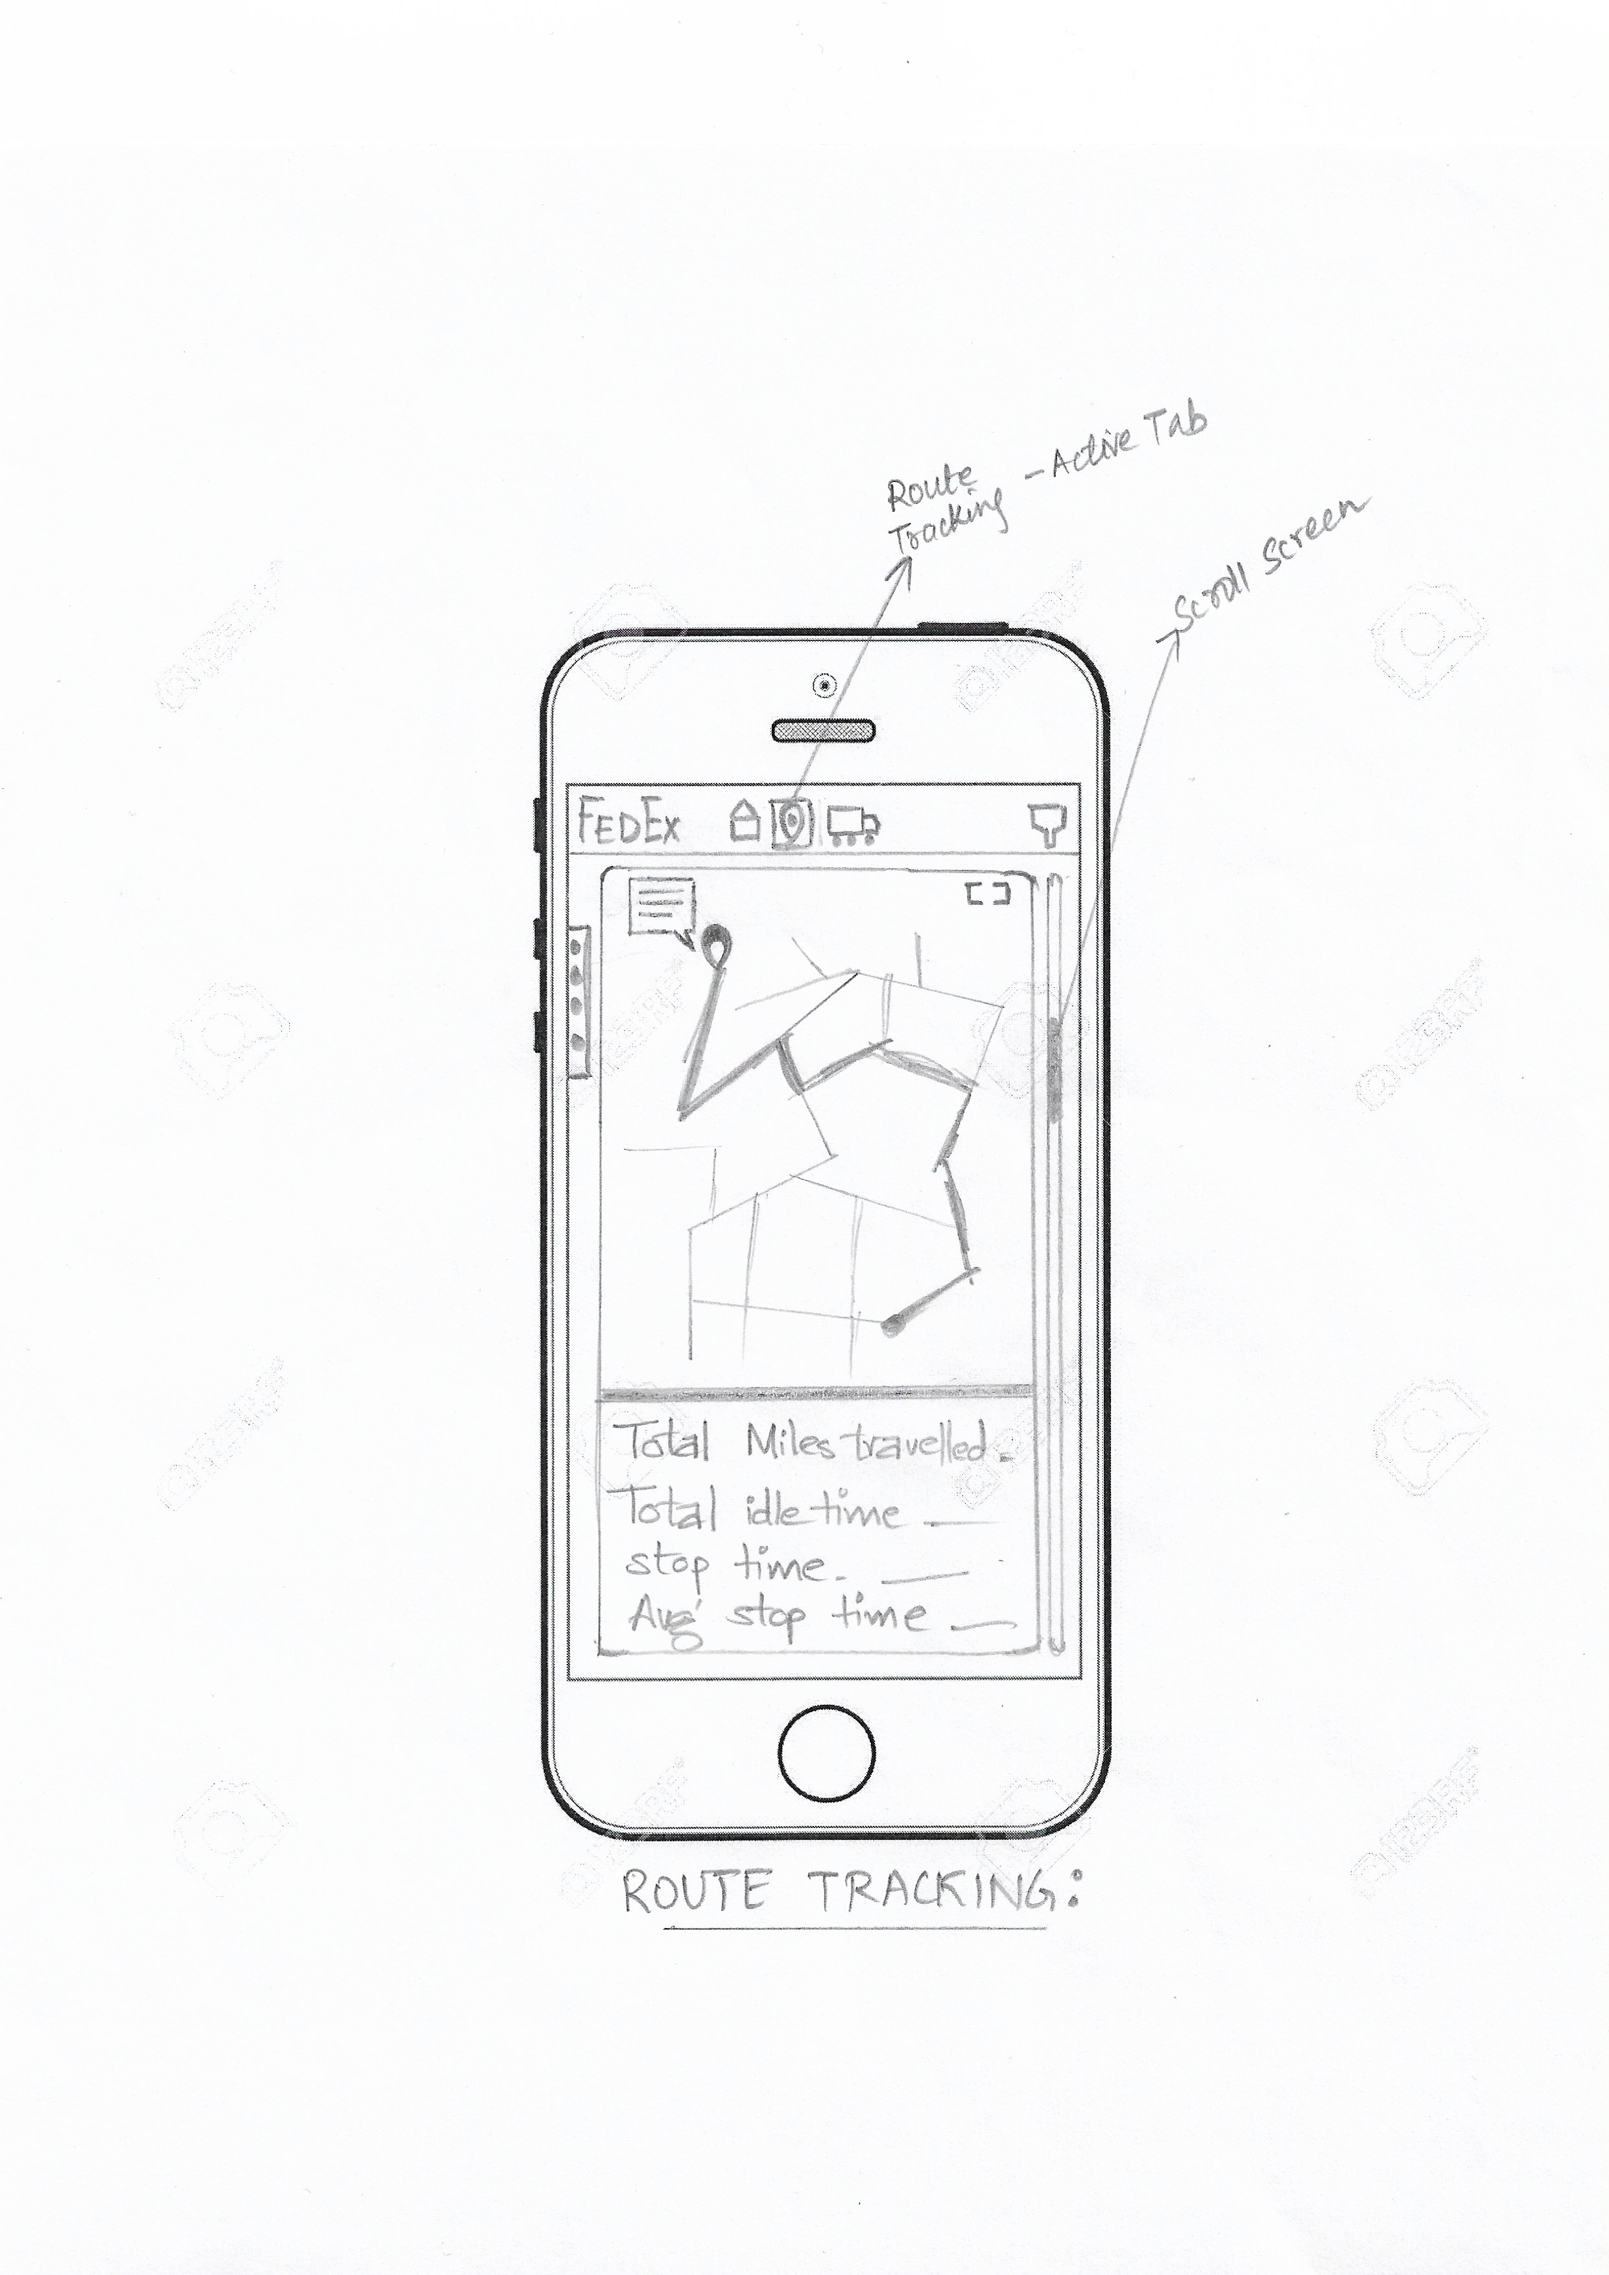
application in mobile view

Slide 11
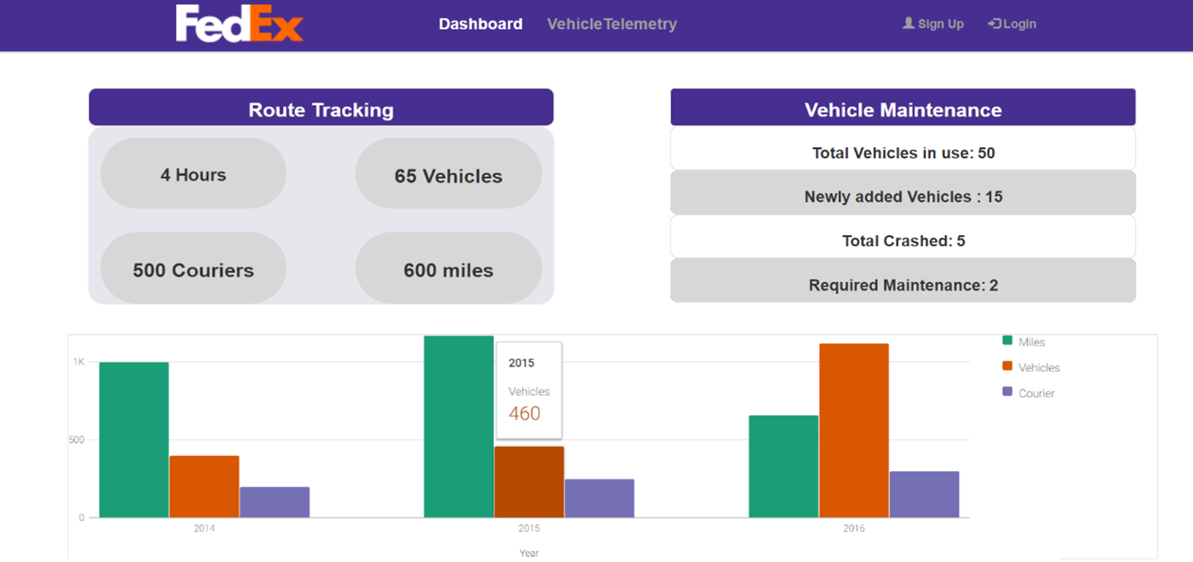
Previous Checkpoint- Dashboard

Slide 12
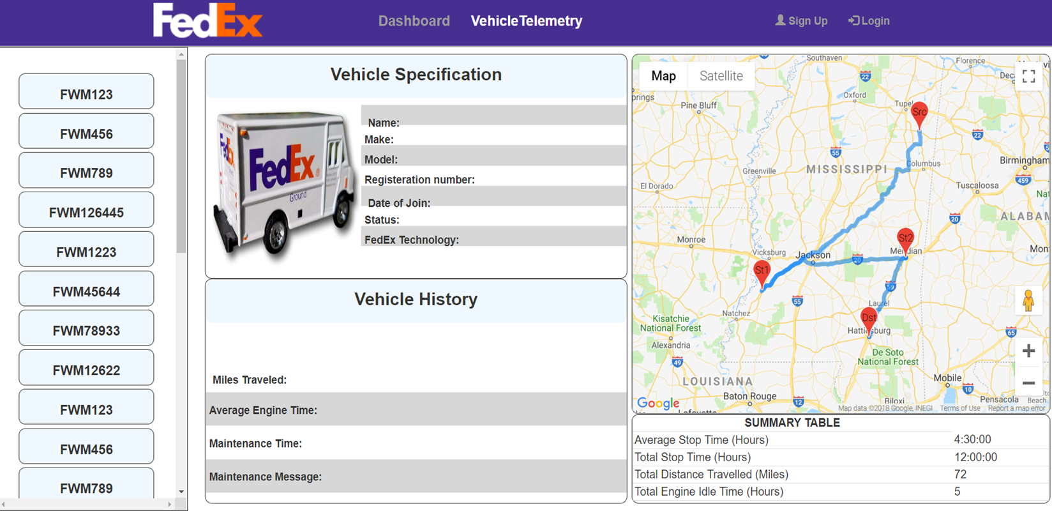
Previous Checkpoint- Vehicle Maintenance screen

Slide 13
FEEDBACKS INCORPORATEd.
Bar graph were modified to depict single attribute instead 3 attributes together.
Search and Filters were implemented.
Line in the map can be removed.
White Color to the Search Button has been changed.
Extra functionality of Calendar, Contacting Driver have been added.

Slide 14
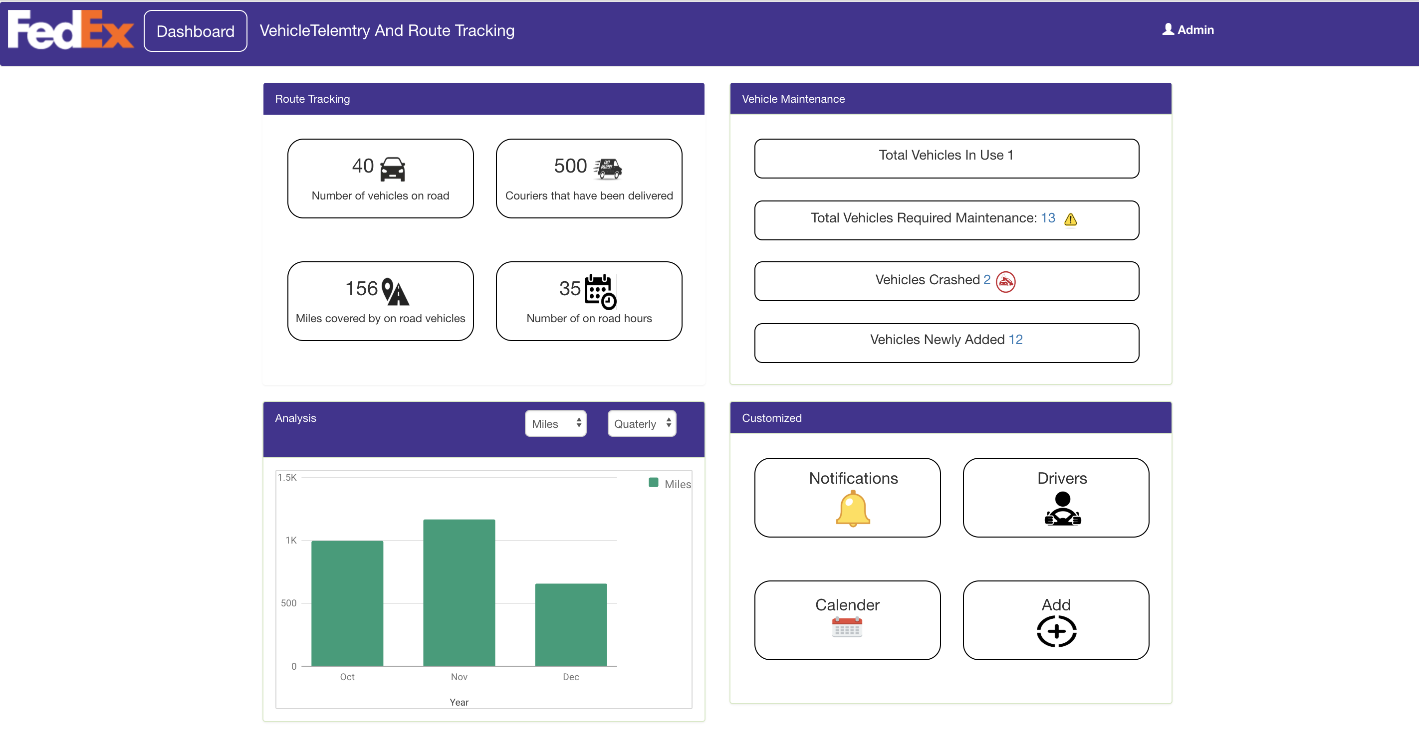
Dashboard

Slide 15
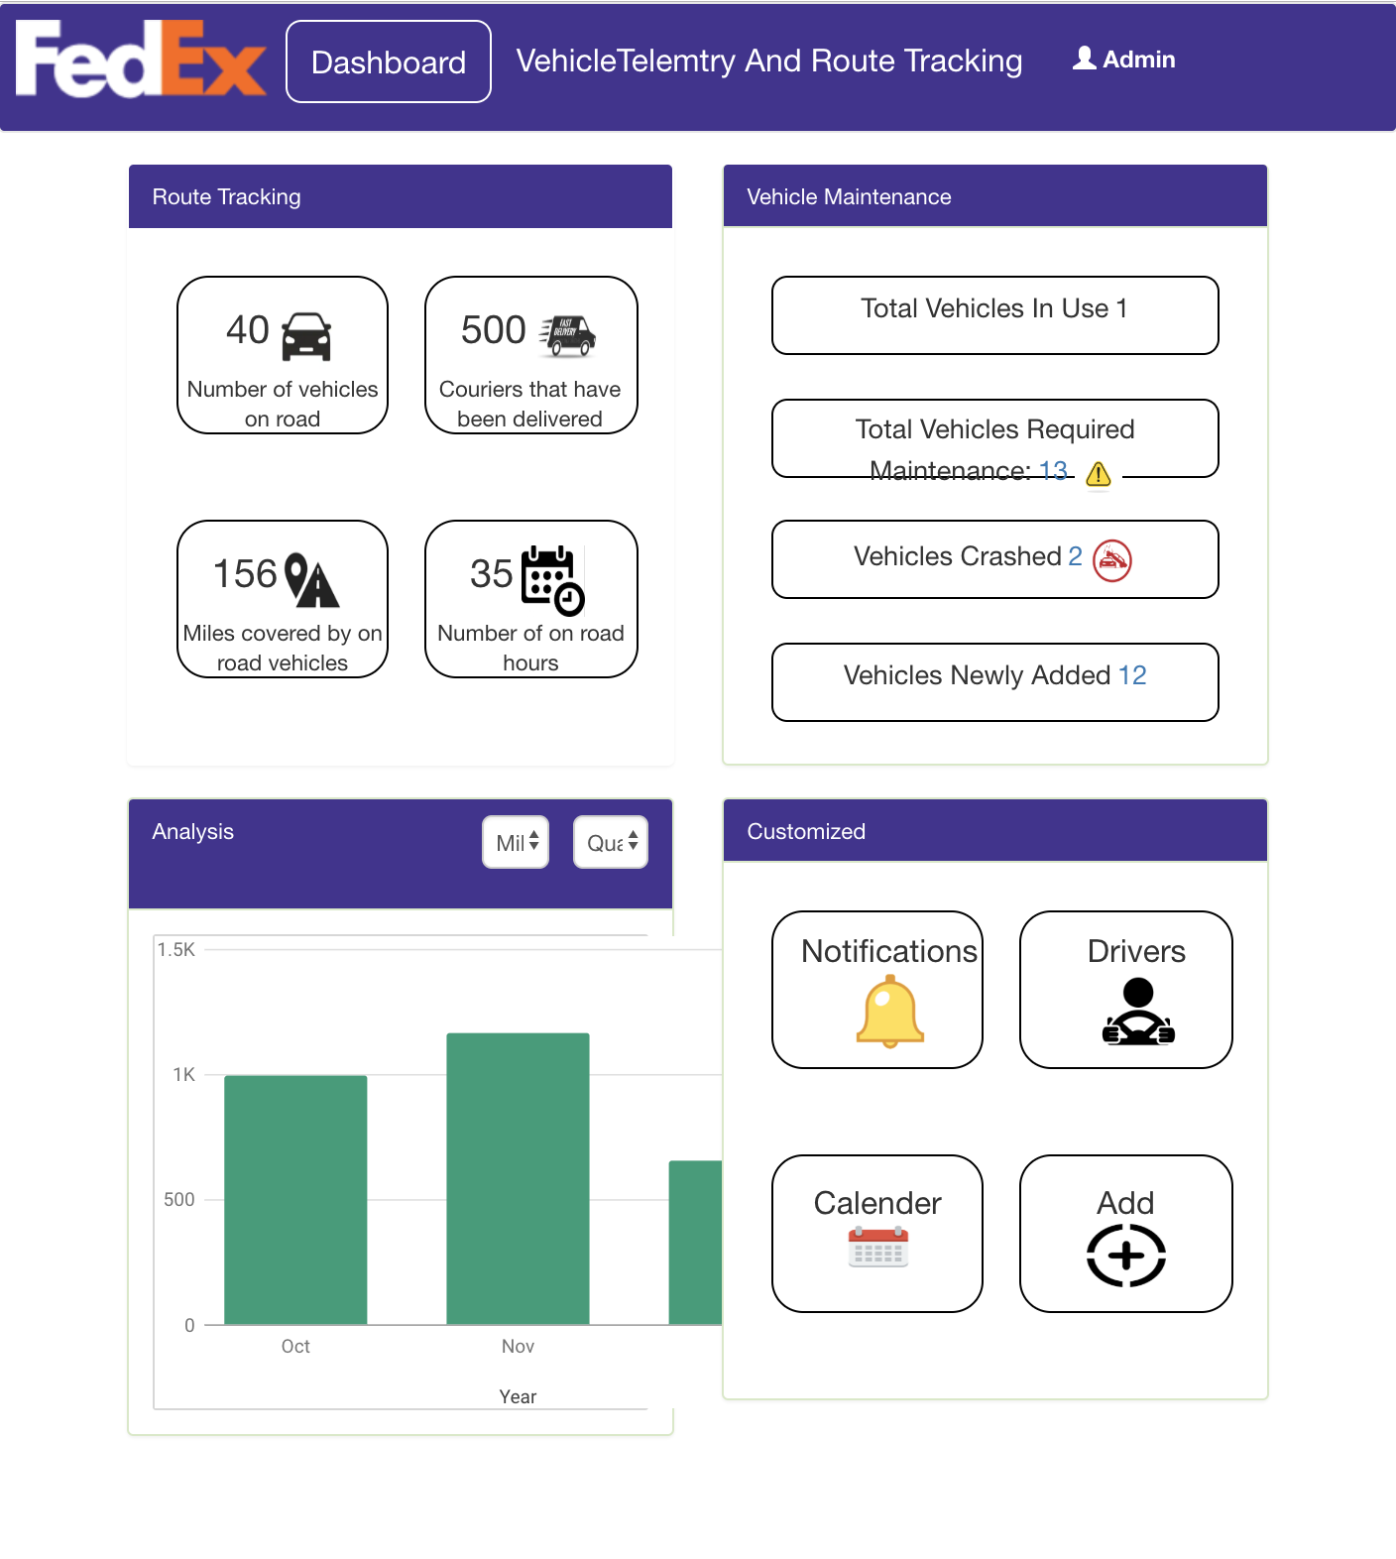
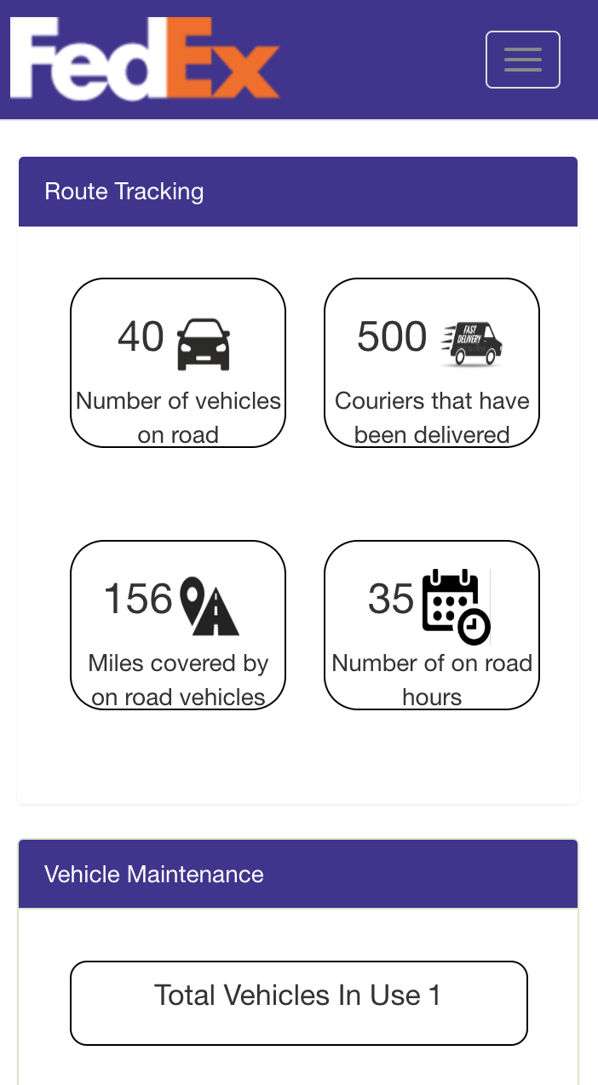
Dashboard (Tablet & Mobile view)

Slide 16
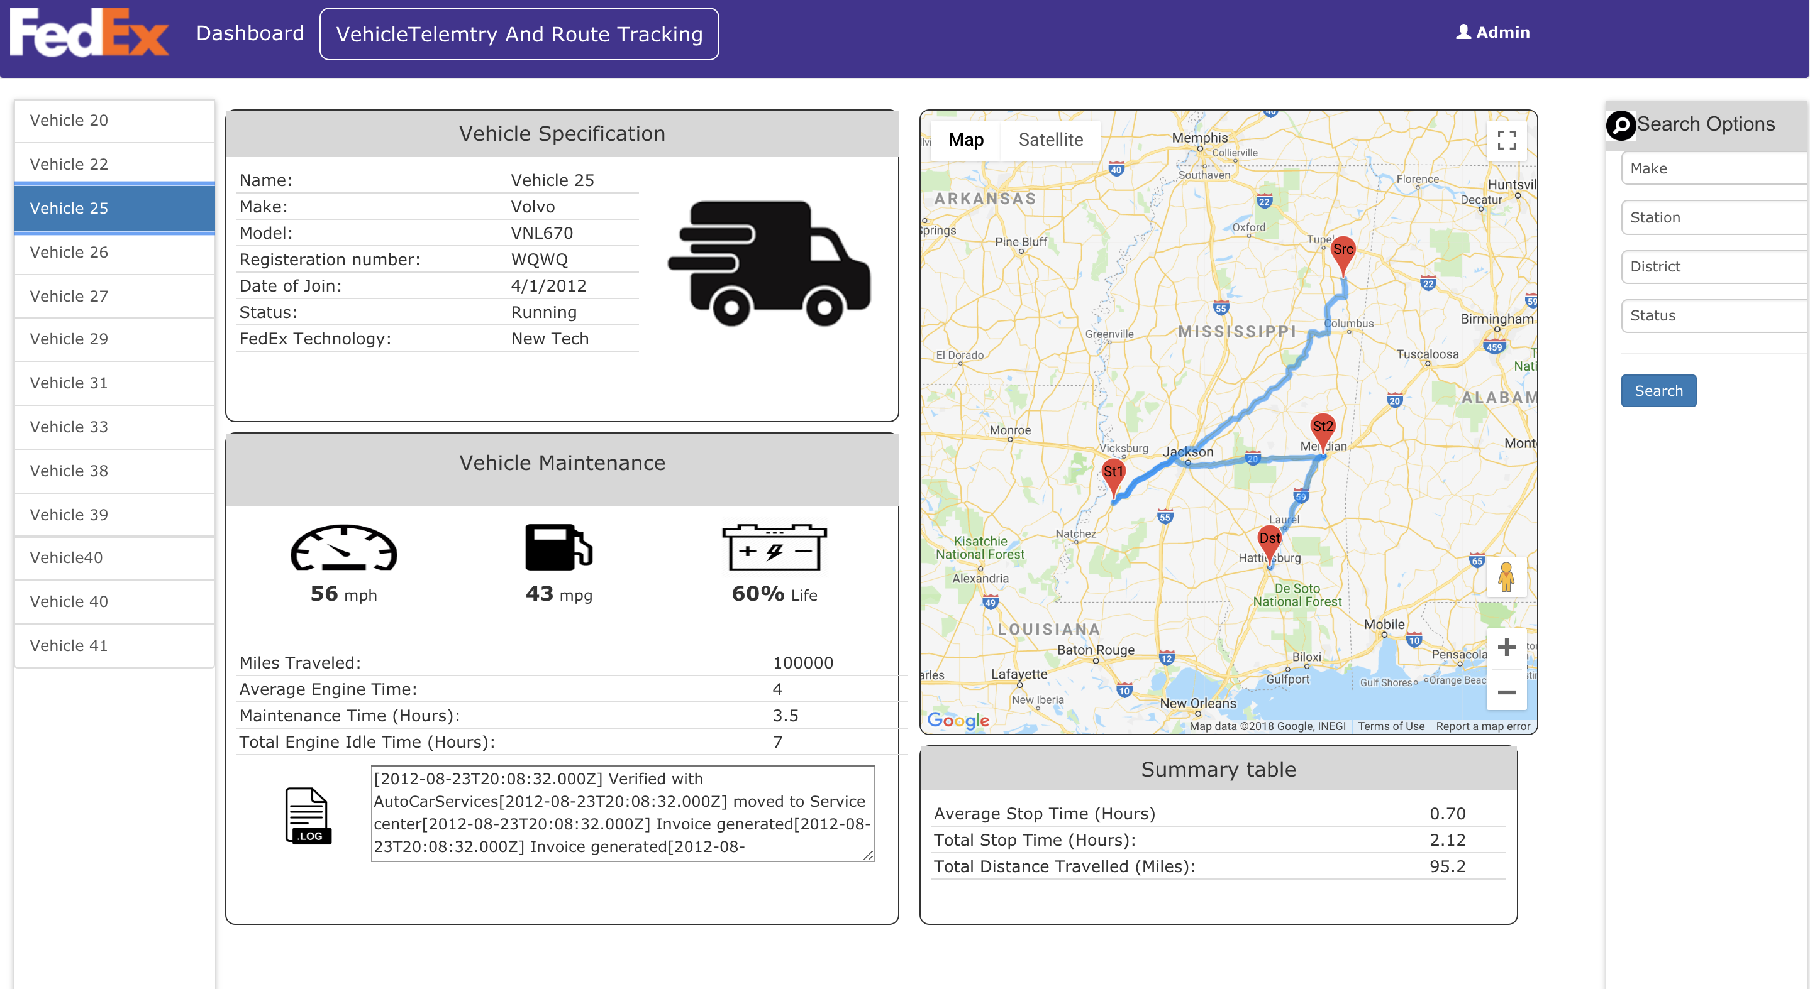
Vehicle telemetry and route tracking

Slide 17
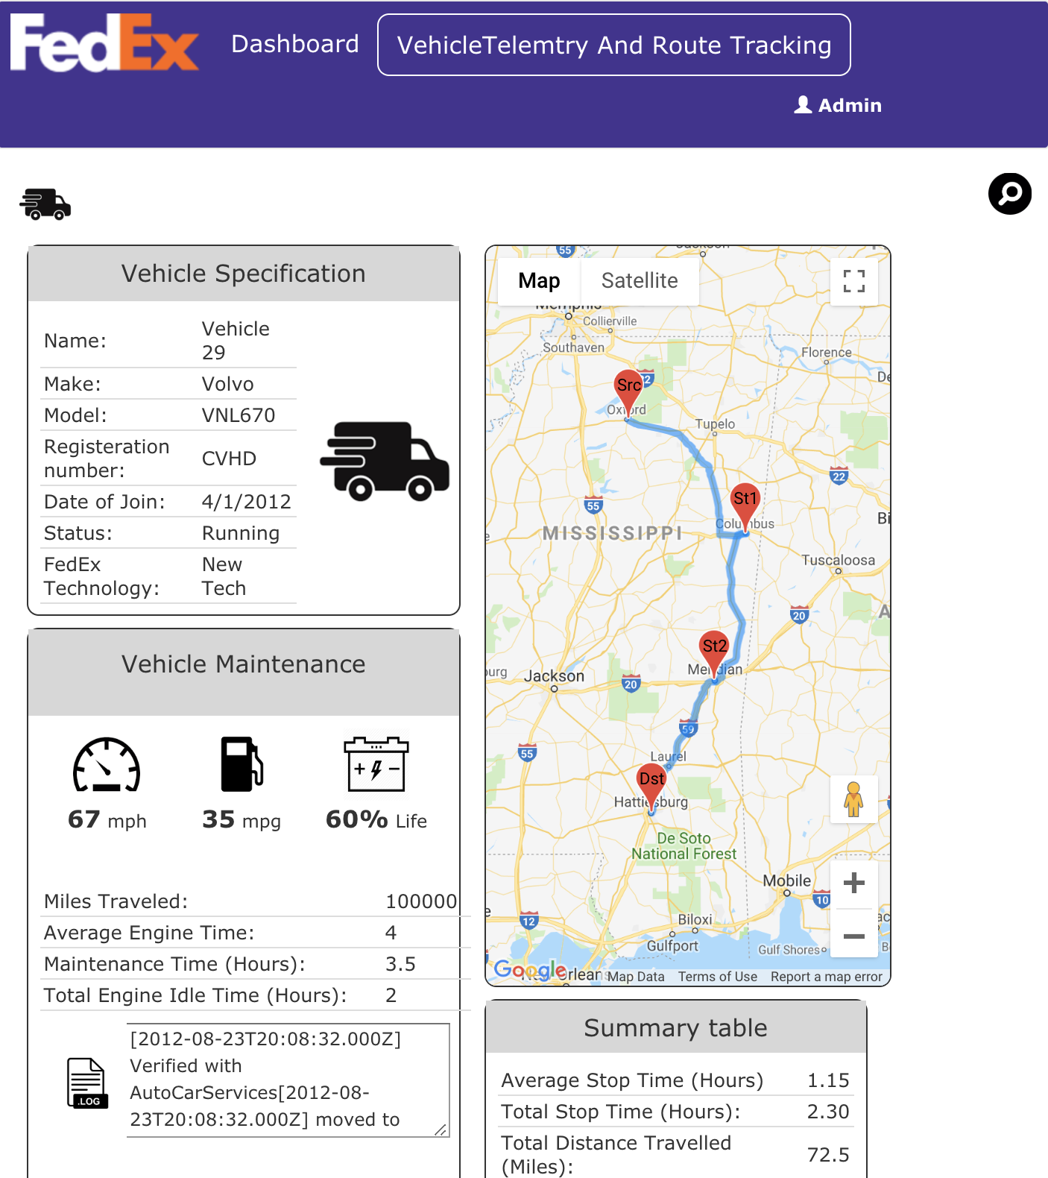
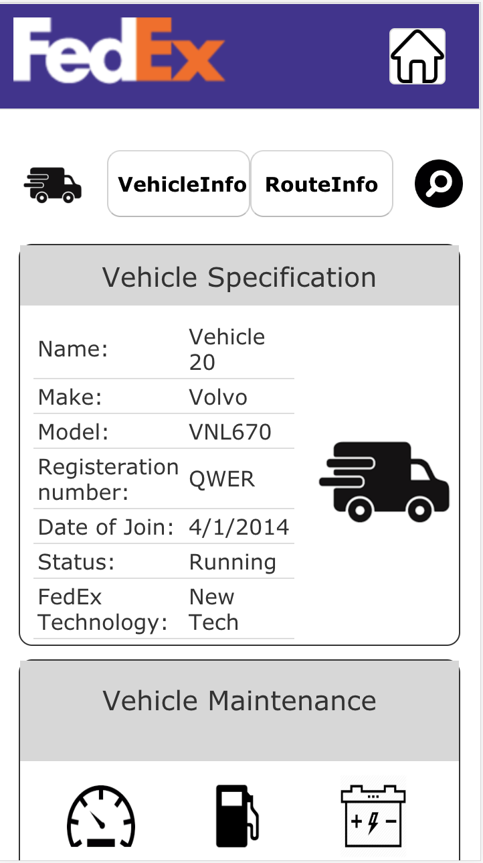
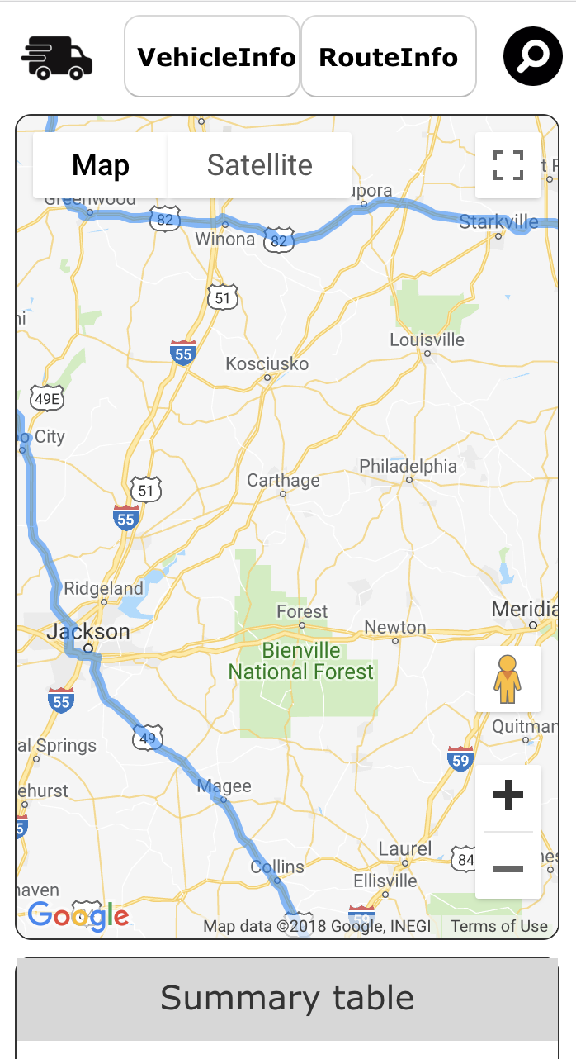
Vehicle telemetry and route tracking

Slide 18
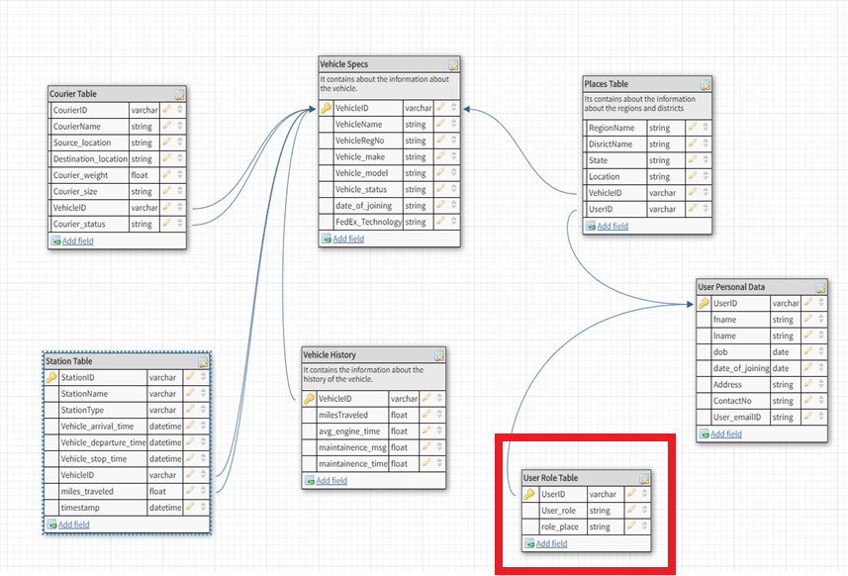
Database design
Vech Spec Table
Vech History Table
Station Table
Courier Table
Places Table
User Personal Table
MySQL database Workbench 8
Hibernate 4.0

Slide 19
Future Work
Functionality to contact vehicle drivers through email, text message can be implemented.
Functionality to forward emergency information to service center to take action can be implemented.
Route Tracking can be used with real-time data .
Route planning algorithms can be implemented to tell drivers beforehand the best possible route.

Slide 20
Questions?

